Slide 1

QOKD/QKD
RECONCILIATION APP
Diogo Matos

Slide 2
Input
CV QOKD LDPC
One or more files with raw key material;
Correction matrix (parity check matrix);
Input parameters file (e.g. address, ports, key type).
Goal
Generate symmetric or oblivious keys from raw key material.
Location
linkplanner20200819b/sdf/cv_qokd_ldpc/
Output
One or more files with the generated key material.
1

Slide 3
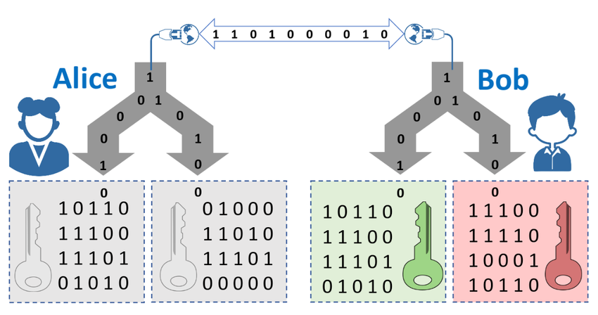
Oblivious key
Example
Alice (Tx) -> 1011000111
Bob (Rx) -> 0111100011
2
Notes:
correction -> Ldpc
sindrome com hash

Slide 4
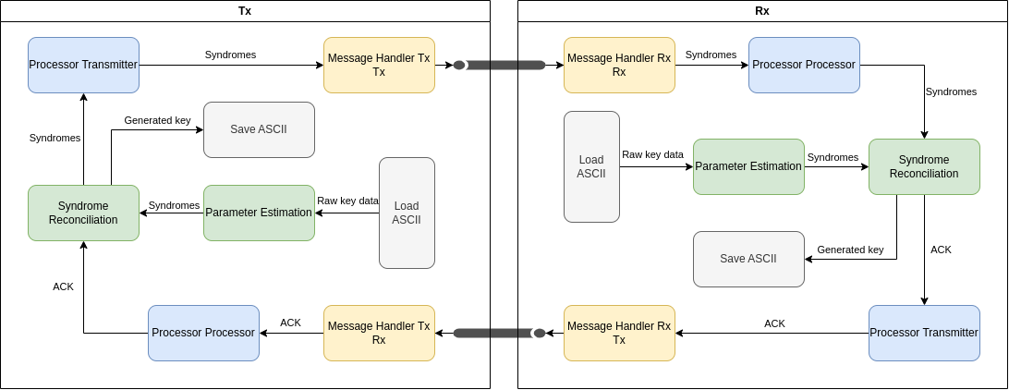
3
Notes:
correction -> Ldpc
sindrome com hash

Slide 5
SM1 | SM2 | ACK
0 | 0 | 00
0 | 1 | 11
1 | 0 | 11
1 | 1 | 11
Symmetric key generation
The same process as presented before;
The ACK messages are used by the Rx to inform the Tx of what syndromes have matched.
In the end both have identical keys, equal to the X oblivious key.
Oblivious ACK
SM1 | SM2 | ACK
0 | 0 | 00
0 | 1 | 01
1 | 0 | 10
1 | 1 | 11
4
Symmetrical ACK
Notes:
A or X

Slide 6


THANK YOU!
Diogo Matos
dftm@ua.pt
Armando Nolosco Pinto
anp@ua.pt

